Slide 1
West Lothian Annual Club Networking Event
Blackburn Partnership Centre 6 June 2024
Kathryn Graham Dalgliesh
(Community Sport Coordinator)
WLC Active Schools & Community Sport Service

Slide 2
Active Schools
Sportscotland works in partnership with all 32 local authorities to invest in and support the Active Schools Network, and has done so for over 13 years.
Within West Lothian, core investment from sportscotland and West Lothian Council equates to 10 FTE Active Schools Coordinators that support the delivery of quality sporting opportunities for children and young people across all secondary, primary and ASN schools.
The main aim of Active Schools is to provide more and higher quality opportunities to take part in sport and physical activity before school, during lunchtime and after school, and to develop effective pathways between schools and sports clubs in the local community.

Slide 3
Community Sport
Team established in 2016
Within West Lothian, core investment from sportscotland and West Lothian Council currently equates to 2 FTE Community Sport Coordinators.
Key focus for sportscotland is the development of Community Sport Hubs
Coordinators take a targeted approach to working with local community clubs, along with other organisations, to support their growth, sustainability, governance, meet community need, empower community leaders and foster community collaboration.
Notes:
Community Sport Coordinators are on hand to work with local community sport clubs and leaders. They provide support to help understand barriers and develop inclusive approaches that ensure everyone can get active. They help establish partnerships, and develop plans and resources to build capacity and capability in community organisations

Slide 4
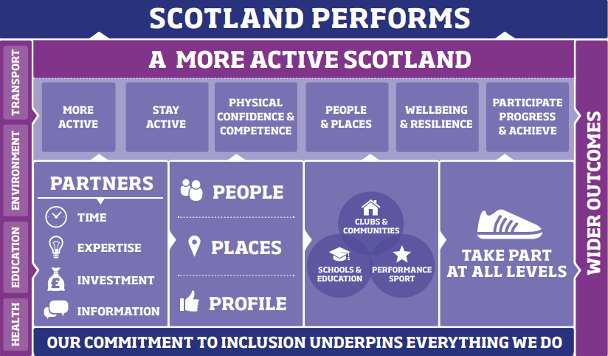
Sportscotland National Strategy, ‘Sport for Life’
Launched in 2019
Notes:
Sportscotland recognised that programmes weren’t fully inclusive and that the role of sport in delivering positive outcomes could have a far greater reach and impact.
As a result, the Changing Lives Through Sport programme was established. Shirley-Anne Smith was accepted onto cohort one and engaged with colleagues from across the sporting sector at various learning and development sessions, but importantly sharing her learning with staff within the service and challenging them to consider the approach we take to our work and how to better imbed the values of equality, diversity and inclusion into our projects and programmes. She progressed on to the Leadership programme and works with a small group of leaders from across the country to help develop a systems based approach to changing lives through sport. A further two staff members, one each from community sport and active schools have subsequently participated in the programme and become local champions.

Slide 5
Our Equality, Diversity and Inclusion (EDI) priorities
Care experienced children and young people
People with a disability
People experiencing physical and mental health issues
People living in poverty or from low income backgrounds
Notes:
We created an EDI working group which took us on a hugely informative journey and led to us identifying these 4 priority areas whilst maintaining a commitment to deliver against all protected characteristics. We took our steer from national and local strategy including Sport for Life and the Local Outcome Improvement Plan for West Lothian. We recognised the importance of having both sport and social outcomes for our service which leads us to where we are at now. Additional investment from sportscotland to allow us to take this targeted E, D, I approach with myself in a leadership role, Demi Mitchell and Matthew Sommerville in targeted roles for Active Schools alongside the changing lives champions. On top of that all of our staff are committed to making small changes to the way that they work with each of them delivering against one or more of the priorities above. Throughout this discussion it would be great to find out where you are at in terms of our priorities.

Slide 6
Key Areas of Work
  Partnerships
  Developing People in Sport
  School Sport Events
  Developing Clubs
  Extracurricular activity
  Leadership programmes
  Places for Sport
Notes:
Partnerships
We identify and collaborate with internal and external partners to understand their priorities and to determine common outcomes.
Developing People in Sport
We take a person-centred approach to the recruitment, deployment and development of coaches and volunteers that support the delivery of our programmes.
We coordinate an accessible programme of coach education aligned to Active Assured accreditation across areas such as Child Protection, First Aid and Disability Inclusion.
We promote that learning enhances self-esteem and confidence, encourages connections and social interactions which helps coaches, volunteers and others involved in the delivery and organisation of sport to support their own well-being.
School Sport Events
Children and young people are provided with opportunities to participate at festivals, competitions and other sporting events.
Developing Clubs
We provide opportunities for children and young people to engage with local community sports clubs.
We support clubs to identify and address the needs of their membership and of their wider community.
Extracurricular Activity
We work with schools, clubs and other partners to provide a programme of extracurricular clubs that meets the needs of children and young people.
Leadership Programmes
We support and deliver a range of leadership programmes and qualifications (e.g. Coach Academy West Lothian, Young Ambassadors, School Sport Captains, Primary Leadership) that supports the delivery of sport in schools and local communities.
Places for Sport
We connect the right people to develop the right facilities in the right places
The key to us delivering a successful model for West Lothian is ensuring that we are taking into account both the sport and the social need of targeted communities.

Slide 7
News & Events
Summer Newsletter
Active Schools Changes
School Sport Events
Summer Activity Programme
Bitesize Club Network Event 26th June
CSWL New Partnership Agreement
Active Assured Plus Accreditation
Sporting Grants (October)

